Slide 1

Invoice & Inventory Management System
BY :
Mohammed Yaqoob
Bala Rama Krishna Peddi
ECIS 690 Final Year Capstone Project IIMS
Notes:
1
1

Slide 2
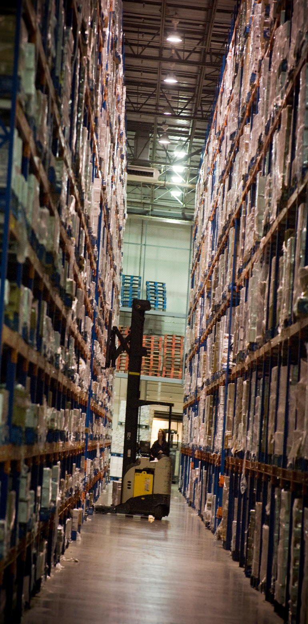
Content :
Introduction
Inventory control
Objectives & Purpose
Hardware & Software Application
Data flow diagram
Data Analysis
Limitations
Future Enhancements
Project features
Snapshots
Conclusion
RACI Chart
Bibliography

Slide 3


INTRODUCTION
What is inventory?
Inventory means goods that we are handling for the purpose of selling profits.
Example:
Raw materials used in production.
Finished goods(Items ready for sale/Distribution).
Unfinished goods(goods which are in process).
Stock of finished goods.
Sparer of critical equipment to ensure continuity of production.

Slide 4
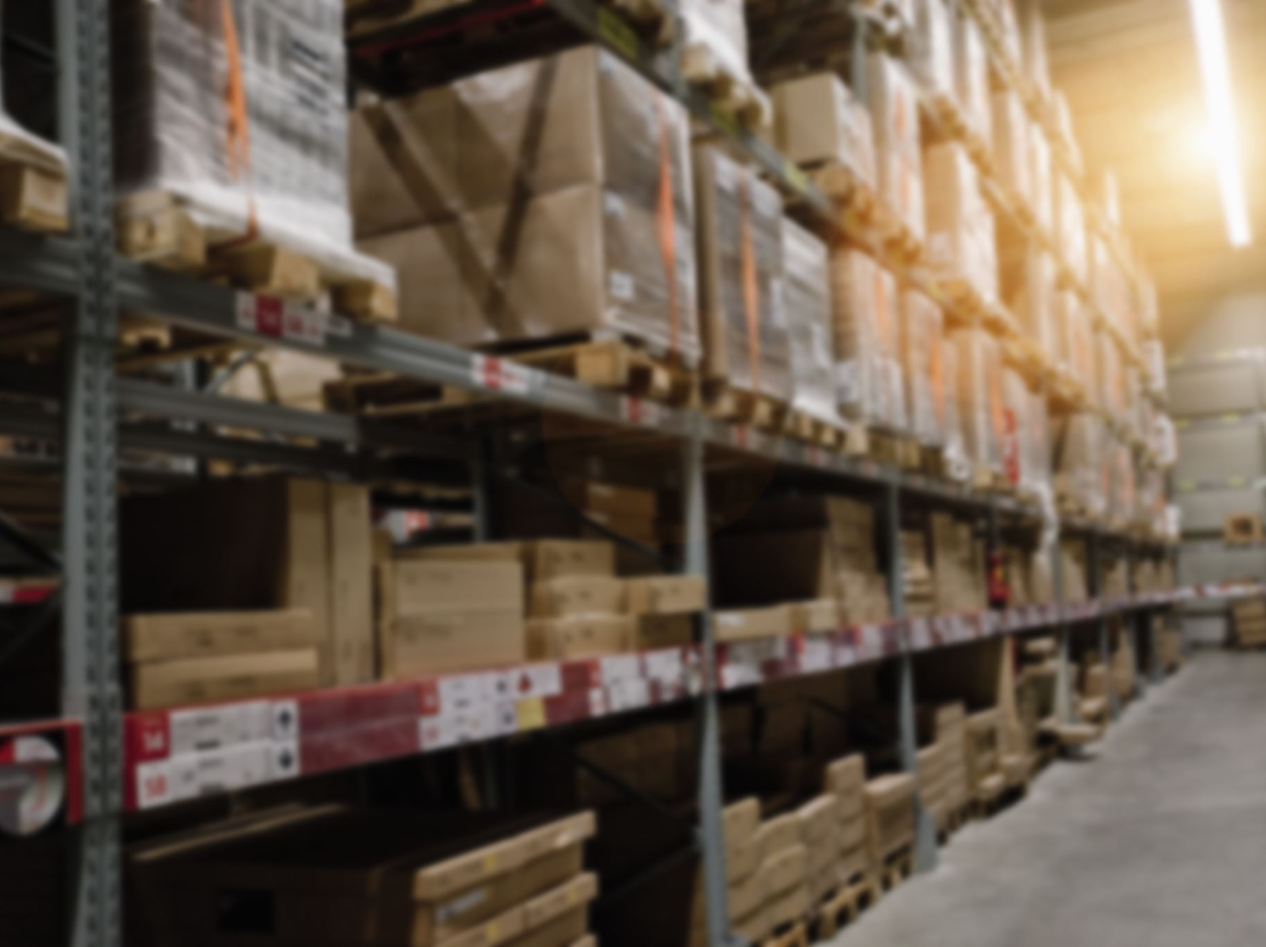
Definition:
Inventory Management is defined as the process of maintaining company stocks at an optimum level to meet customer demands with minimum Inventory costs.
Importance of Inventory :
It helps to achieve customer satisfaction.
It ensures cash flow.
It ensures better warehouse space utilization.
It helps better human resource utilization.

Slide 5
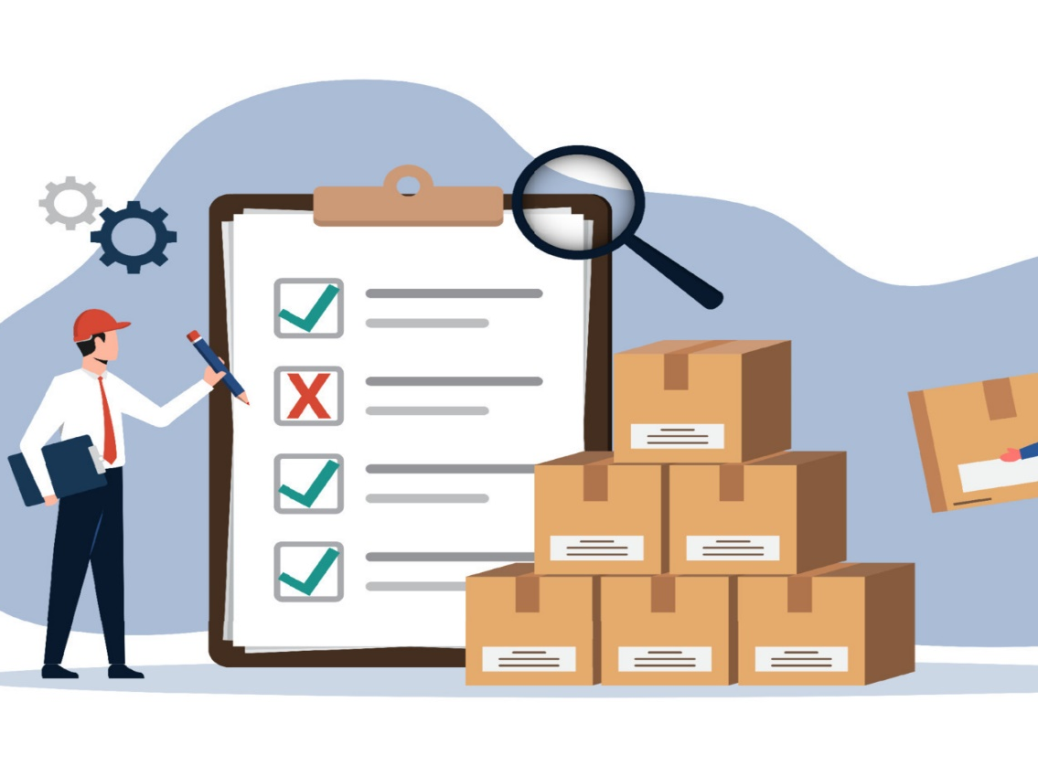
Inventory control
Inventory control helps in the continuity of supplies during gluts & storage.
Inventory control maintains a balance between out-of-stock and over-stock.
Maintain the company’s stock to meet customer demands.
To ensure continuity of production & distribution.

Slide 6
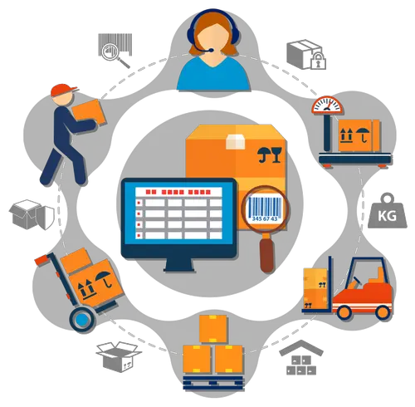
Objectives & purposes
Posting the right products in the right place at right time.
Effectively balance the Inventory coming in & going out.
Better address customer demands.
It improves cash flow.
It helps to save money while over-stocking the fewer demands of products.
To protect against inflation
Effective Inventory management avoids the risk of spoilage, damage, or overstocked products.

Slide 7
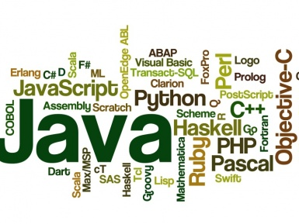
Hardware & software application
These are the tools and languages which we used in the making of the Invoice & Inventory Management System.
MySQL workbench 8.0CE
Eclipse IDE for java Devlopers-2022-12
Jdk 7u21-windows-x64.exe
Java Jit compiler
HTML (hypertext markup language)

Slide 8
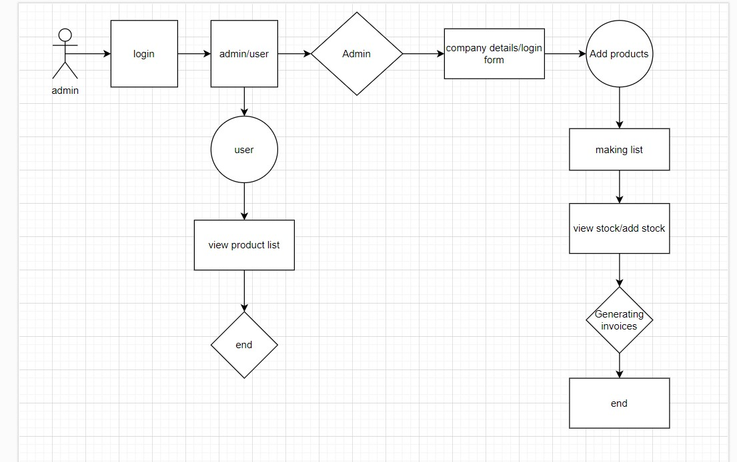
Data flow diagram

Slide 9

DATA ANALYSIS
Problem Identification:
Local gas stations with unorganized and improperly managed inventory
Excess stock, expired products, and stock-outs
Solution Concept:
Develop an application to help analyze and maintain inventory effectively
Benefits:
Translate raw data into meaningful information for small organizations
Organized and efficient stock management

Slide 10

limitations
Since it’s our first project it has some limitations due to less time & knowledge in a particular field and limited time we could not fulfill the project as per our expectations as we expected when we start the project. We hope this limitation is considerable. The limitations are:
It is not suitable for large organizations.
It’s not suitable for a large number of products.
Limited area is covered.
You must have a PC/Laptop.
Less secure.
Multi users are not supported.

Slide 11


Future enhancements
Dashboard.
Multi language.
Barcode scanning.
Multiple users and their roles.
Employee management.
Manage stock store-wise.
Online banking system.
Lost and breakage.
Flexibility.
Return or exchange products.

Slide 12
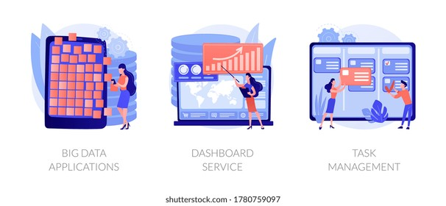
Project features
User Registration Page:
Registration form for user sign-up
Contact Us Page:
Address, contact numbers, email IDs, and location map
About Us Page:
Project members' information

Slide 13

Project features(extension)
Admin Form:
View users: Accept user registration requests
Add products: Form to add products to inventory
Product list: View products in inventory
Add stock: Add product quantities to inventory
View Stock: Check stock availability
Logout: Admin can log out
User Form:
View profile: View the user or organization profile
Change password: Update user password
Logout: The user can log out

Slide 14
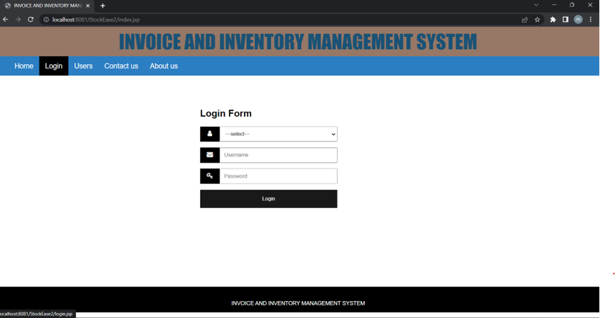
Snapshots
Login form

Slide 15
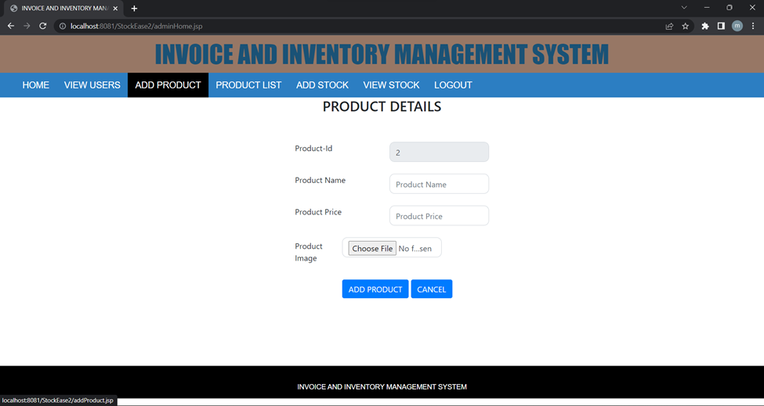
Screen shot

Slide 16
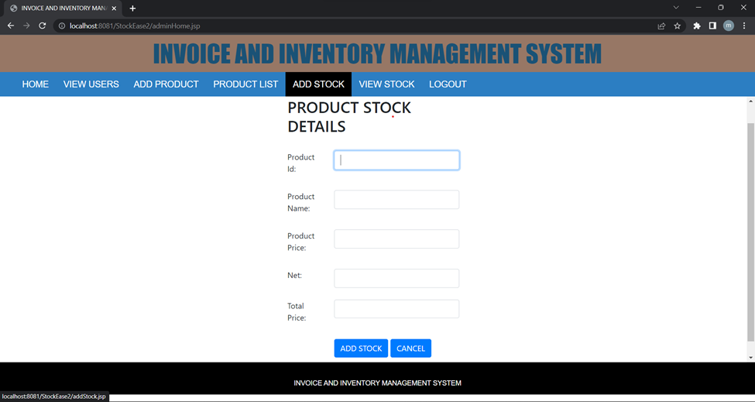
Screenshot

Slide 17
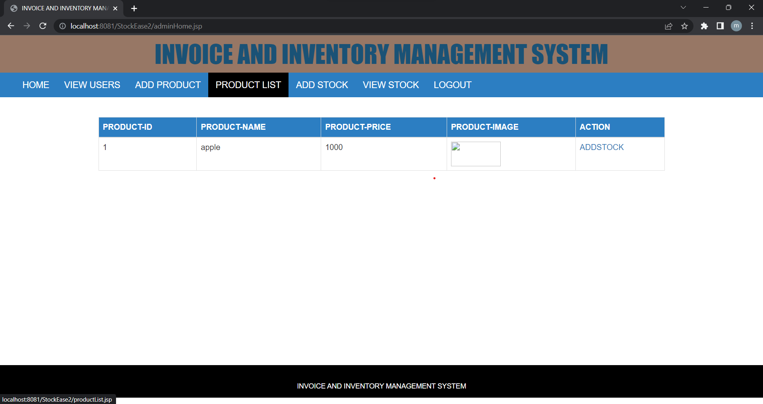
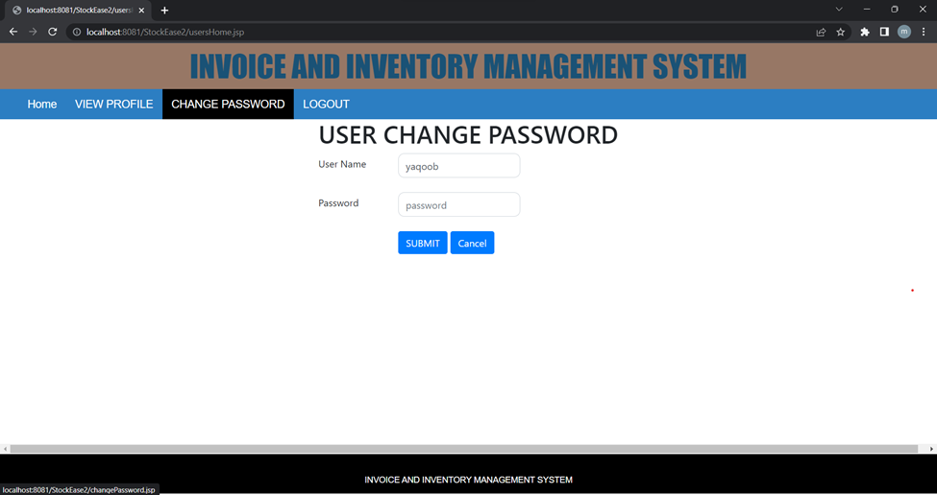

Slide 18
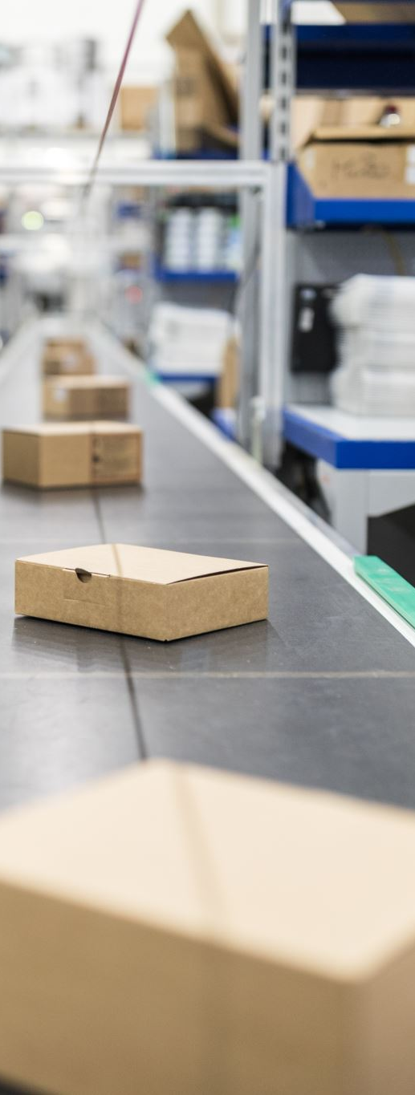
conclusion
Inventory management is an important function in controlling assets in the supply chain. The invoice & Inventory Management system helps to organize the stock and arrange and Run the business in an efficient manner to get more profits. Individuals working in the supply chain should have at least a basic understanding of inventories’ roles, costs, and benefits. Understanding the basics of inventory management enables them to effectively contribute to an organization.
Inventory is a function in an organization's overall supply chain processes. Inventory is often obtained from suppliers in the form of raw materials and other goods and materials through the procurement department. Inventory also includes work in process and finished products from manufacturing operations.
Firms hold inventory to meet the needs of their customers.

Slide 19
RACI CHART
Index | Tasks | Rama Krishna | Mohammed Yaqoob
 | Invoice and Inventory Management | Role | Role
1.0 | Capstone Project Registration
1.1 | Submit proposal | R | R
1.2 | Topical approval | R | R
1.3 | Course Registration | R | R
2.0 | Orientation
2.1 | Attend Orientation class |  | R
2.2 | Complete Orientations class | R | R
2.3 | Read all canvas Information | R | R
3.0 | Assignments
3.1 | Final proposal | R | A
3.2 | Complete outline | A | R
3.3 | Weekly status | A | R
3.4 | Interm report | R | A
3.5 | final report | A | R
3.6 | Final presentation | R | R
3.7 | Oral Presentation | R | R
4.0 | Development
4.1 | Authentication page
4.2 | Navbar for admin user | C | R
4.3 | Login for admin | R | C
4.4 | Logout Functionality | C | R
4.5 | Registration Page for users | R | A
4.6 | Login for Users | A | R
4.7 | View the profile of the user | A | R
4.8 | Change the password for the user | R | R
4.9 | Logout Functionality for User | A | R

Slide 20
R = Responsible – those who do the work to complete the task A = Accountable – one person answerable for completion of the task (approves R’s work) C = Consulted – Look for the opinions, Such as subject matter experts (SMEs) I = Informed – Those to keep up-to-date
5.0 | User and admin Functionality
5.1 | Add product from | R | A
5.2 | Accept user request by admin when created user | A | R
5.3 | Contact Us page on the cover page | A | R
5.4 | About us Page on a cover page | R | A
5.5 | Adding stock | A | R
5.6 | Viewing Stock | R | A
5.7 | Generating Invoices | A | R
6.0 | Documentation
6.1 | The idea of the project | A | R
6.2 | Research on project | A | R
6.3 | Making draft paper | A | R
6.4 | Submitting draft paper | R | R
6.5 | Interm report | R | R
6.6 | Writing and communication center(appointment) | R | R
6.7 | Making documentation | A | R
6.8 | Finalizing Documentation | A | R
6.9 | Making PPT | A | R
7.0 | Oral Presentation | A | R

Slide 21

BIBLIOGRAPHY
https://www.zoho.com/us/inventory/
https://pos.toasttab.com/
https://www.forbes.com/advisor/business/software/best-free-invoice-software/
Supply chain Analytics (ECIS-634-R)
Data Science( ECIS-638-U)

Slide 22
Thanks

